Slide 1

Cultural Repatriation
By David Stahr
Notes:
Add a date for presentation!!!!

Slide 2
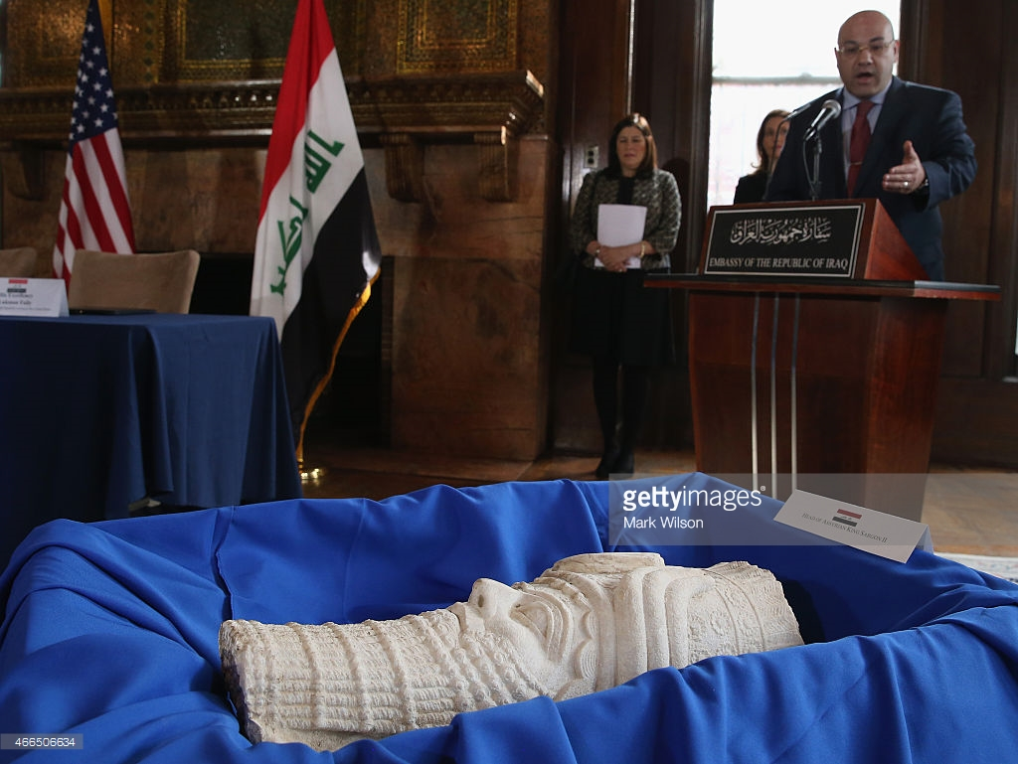
Focus
Focus
Should cultural artifacts that have made their way into Western museums from imperialism be return back to their country of origin?
Should cultural artifacts that have made their way into Western museums from imperialism be returned to their country of origin?

Slide 3
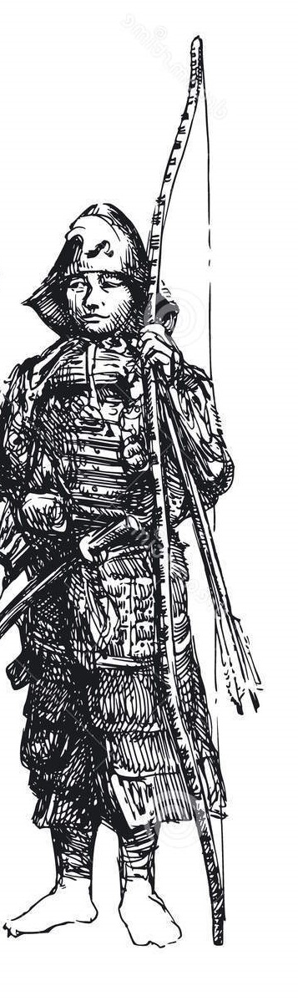
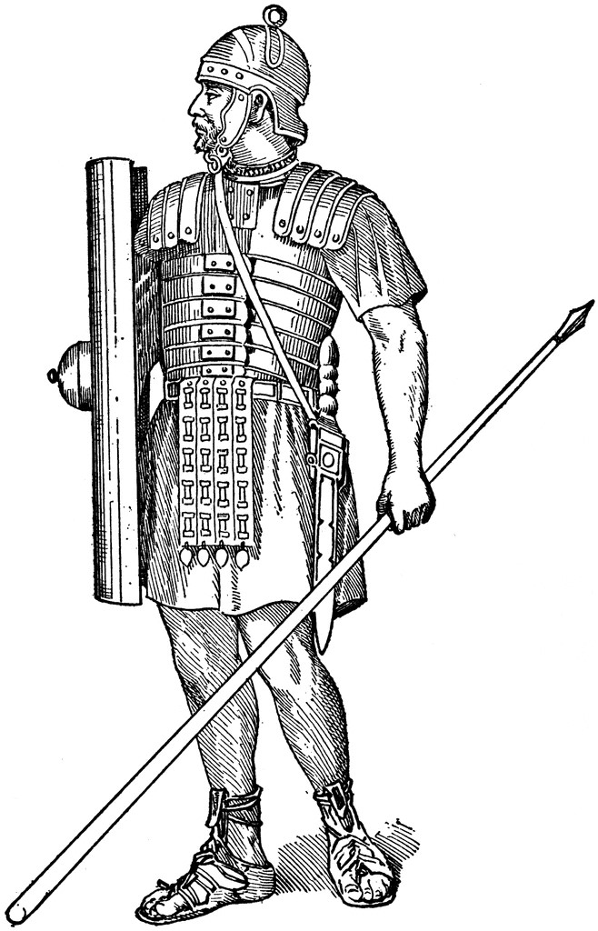

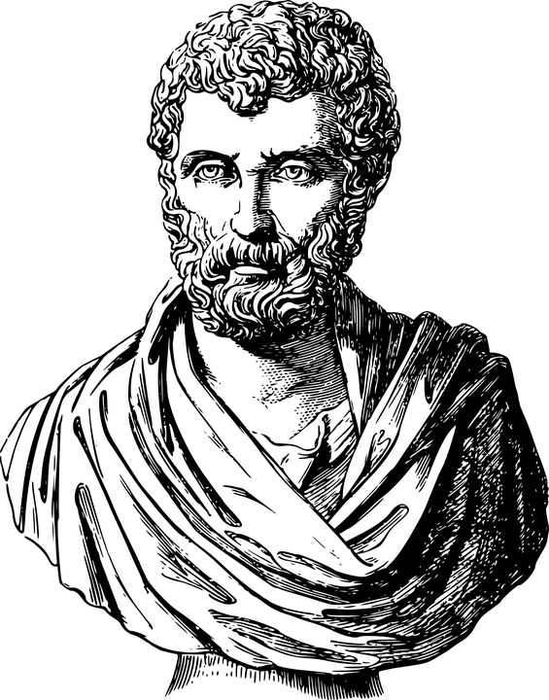
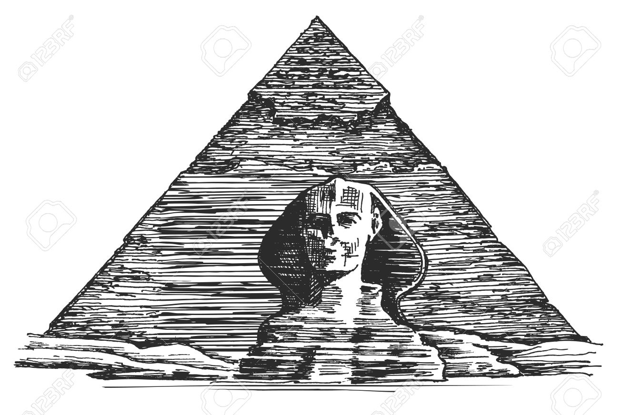
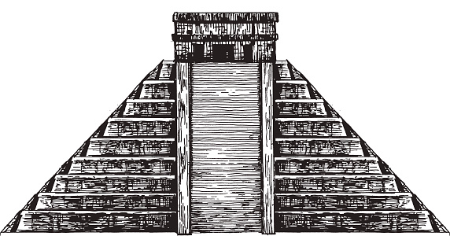
Humanity: A Collective History

Slide 4

Position: Conditional Repatriation
Historical cultural artifacts belong to all of people of the world and not solely their country of origin. As a result, the demands for these artifacts to be brought back to their native lands should only be permitted if they can be safeguarded.

Slide 5
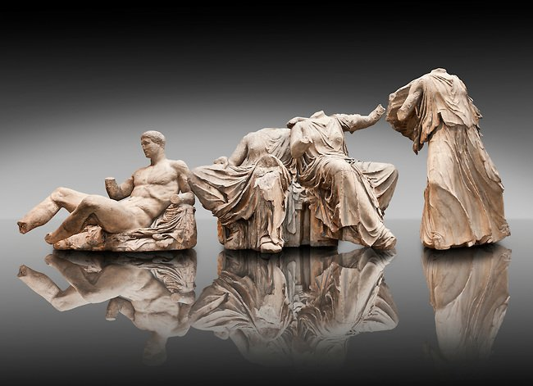
Case One: Greece

Slide 6
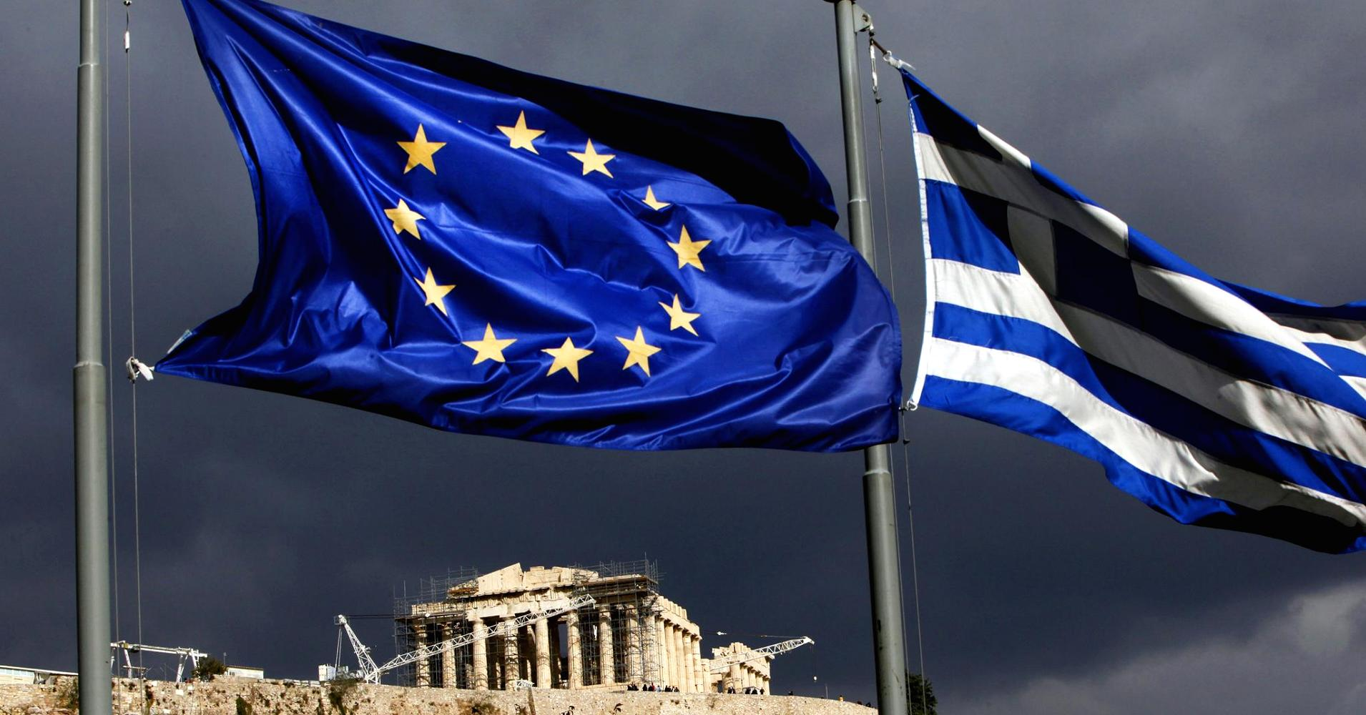
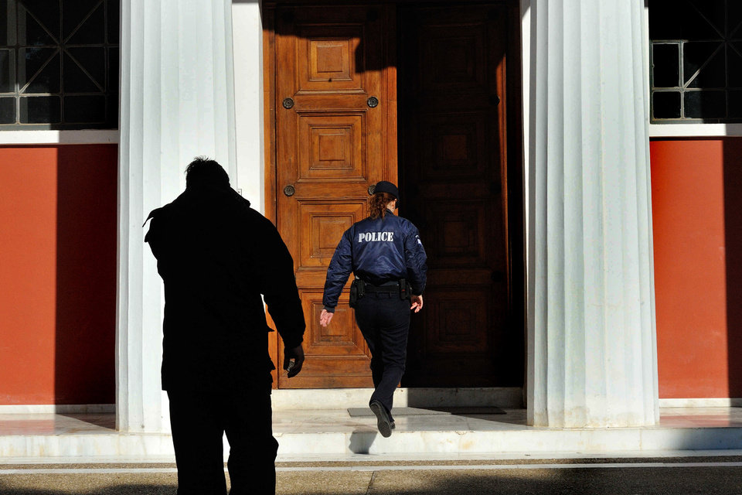
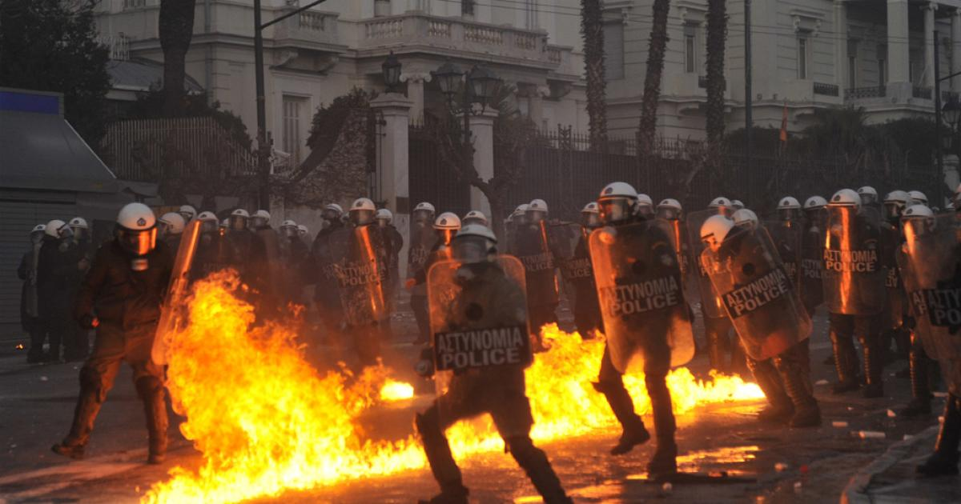

Slide 7
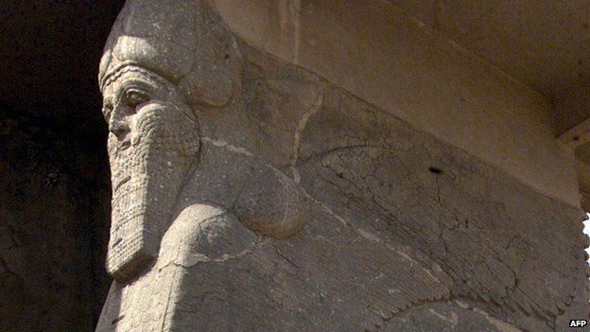
Case Two: Nimrud Iraq

Slide 8
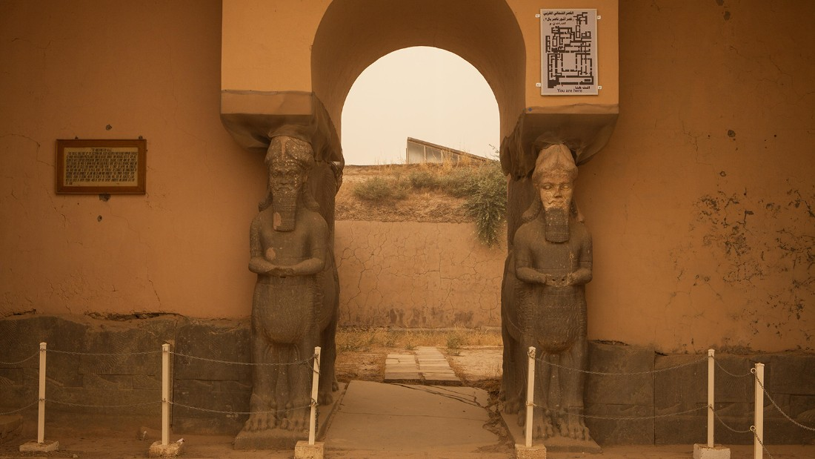
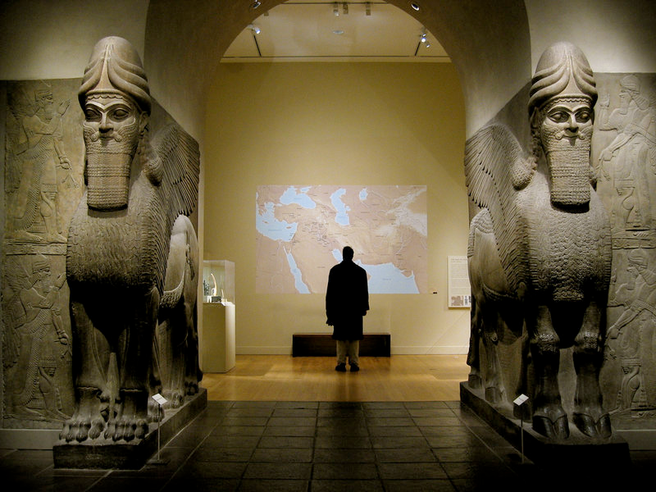
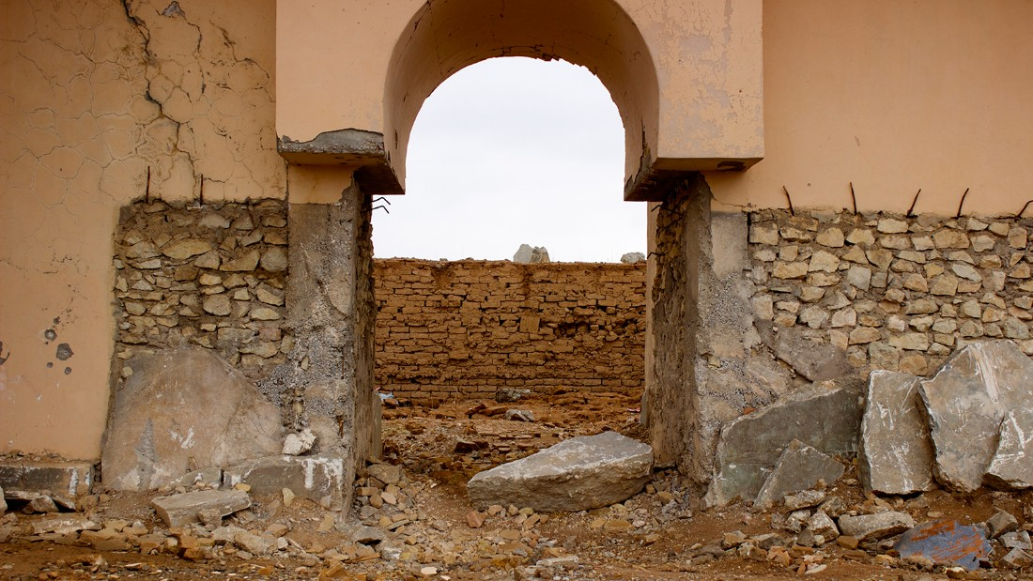

Slide 9
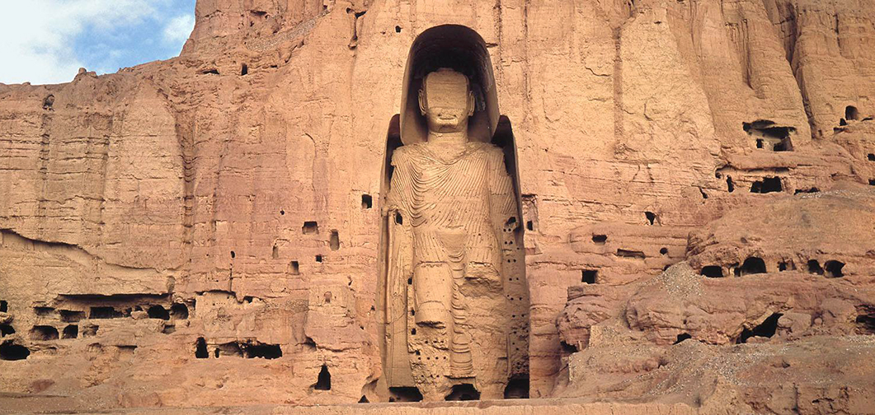
Case Three: The Bamiyan Buddhas

Slide 10
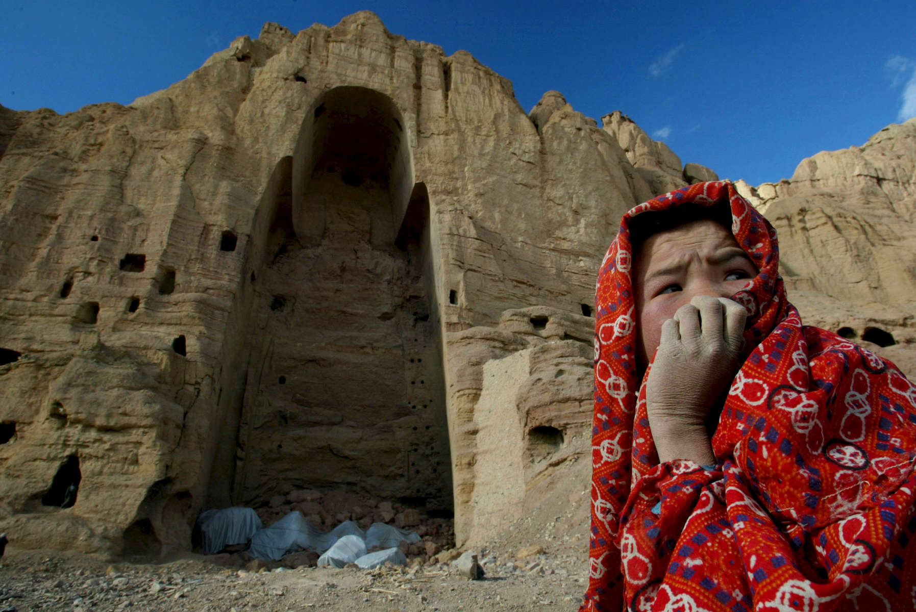
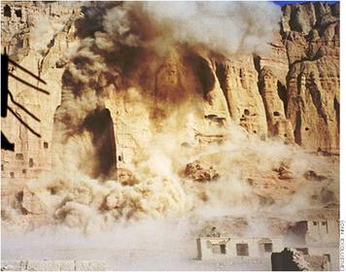

Slide 11
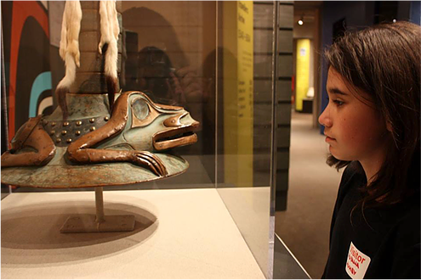
Counter Arguments
Western Counties do not have a right to claim these artifacts
They were stolen
It is a sovereign right for a nation to reclaim its history
Notes:
Add the the alternative view text (i.e. restorative justice)

Slide 12
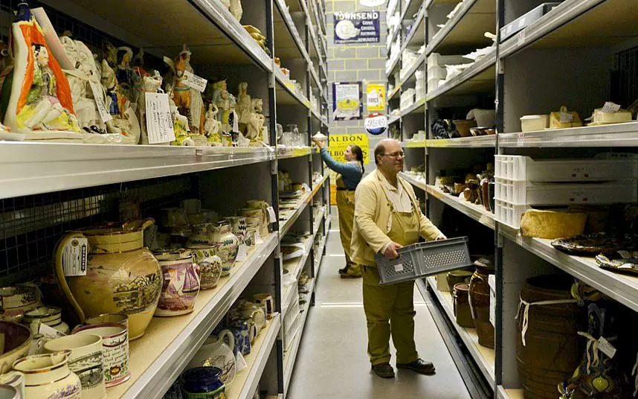
Restorative Justice
“Words cannot describe the grief that is felt by indigenous people as they visit their ancestors, locked away for decades, sometimes centuries, in large institutions far away from their homelands” - Barbara Mumby

Slide 13

Cosmopolitan Ethics Justice
Part of one single community
The greatest good for the greatest number of people
Sovereignty should come second to the protection of cultural artifacts

Slide 14

Conditional Repatriation: A Happy Compromise
Not Saying that cultural artifact should never be returned
Just that it should not be an automatic process
This is best way to protect history

Slide 15
Works Cited
"Flashback: The Destruction of the Buddhas of Bamiyan." NBC News, www.nbcnews.com/feature/flashback/video/flashback-the-destruction-of-the-buddhas-of-bamiyan-409457219869. Accessed 20 Apr. 2017.
Labropoulou, Elinda. "Greece: Robbers Raid Olympia Museum, Steal Artifacts." CNN, Turner Broadcasting System, 17 Feb. 2012, www.cnn.com/2012/02/17/world/europe/greece-museum-robbery/. Accessed 20 Apr. 2017.
Mumby, Barbara. "Returning the Sacred: Museums and International Repatriation of Native North American Cultural Property." John F. Kennedy University Museum Studies, 12 July 2016,
www.jfkumuseumstudies.org/single-post/2016/07/13/Returning-the-Sacred-Museums-and-International-Repatriation-of-Native-North-American-Cultural-Property. Accessed 21 Apr. 2017.

Slide 16
Works Cited
Romeo, Nick. "Strapped for Cash, Some Greeks Turn to Ancient Source of Wealth." National Geographic, 17 Aug. 2015, news.nationalgeographic.com/2015/08/150817-greece-looting-artifacts-financial-crisis-archaeology/. Accessed 20 Apr. 2017.
Seiff, Abby. "How Countries Are Successfully Using the Law to Get Looted Cultural Treasures Back." American Bar Association, 1 July 2014, www.abajournal.com/magazine/article/how_countries_are_successfully_using_the_law_to_get_looted_cultural_treasur. Accessed 21 Apr. 2017.
Smith, Helena. "Greece looks to international justice to regain Parthenon marbles from UK." Guardian, 8 May 2016, www.theguardian.com/artanddesign/2016/may/08/greece-international-justice-regain-parthenon-marbles-uk. Accessed 20 Apr. 2017.
Woodruff, Judy, host. PBS NewsHour. 12 Apr. 2017.

Slide 17
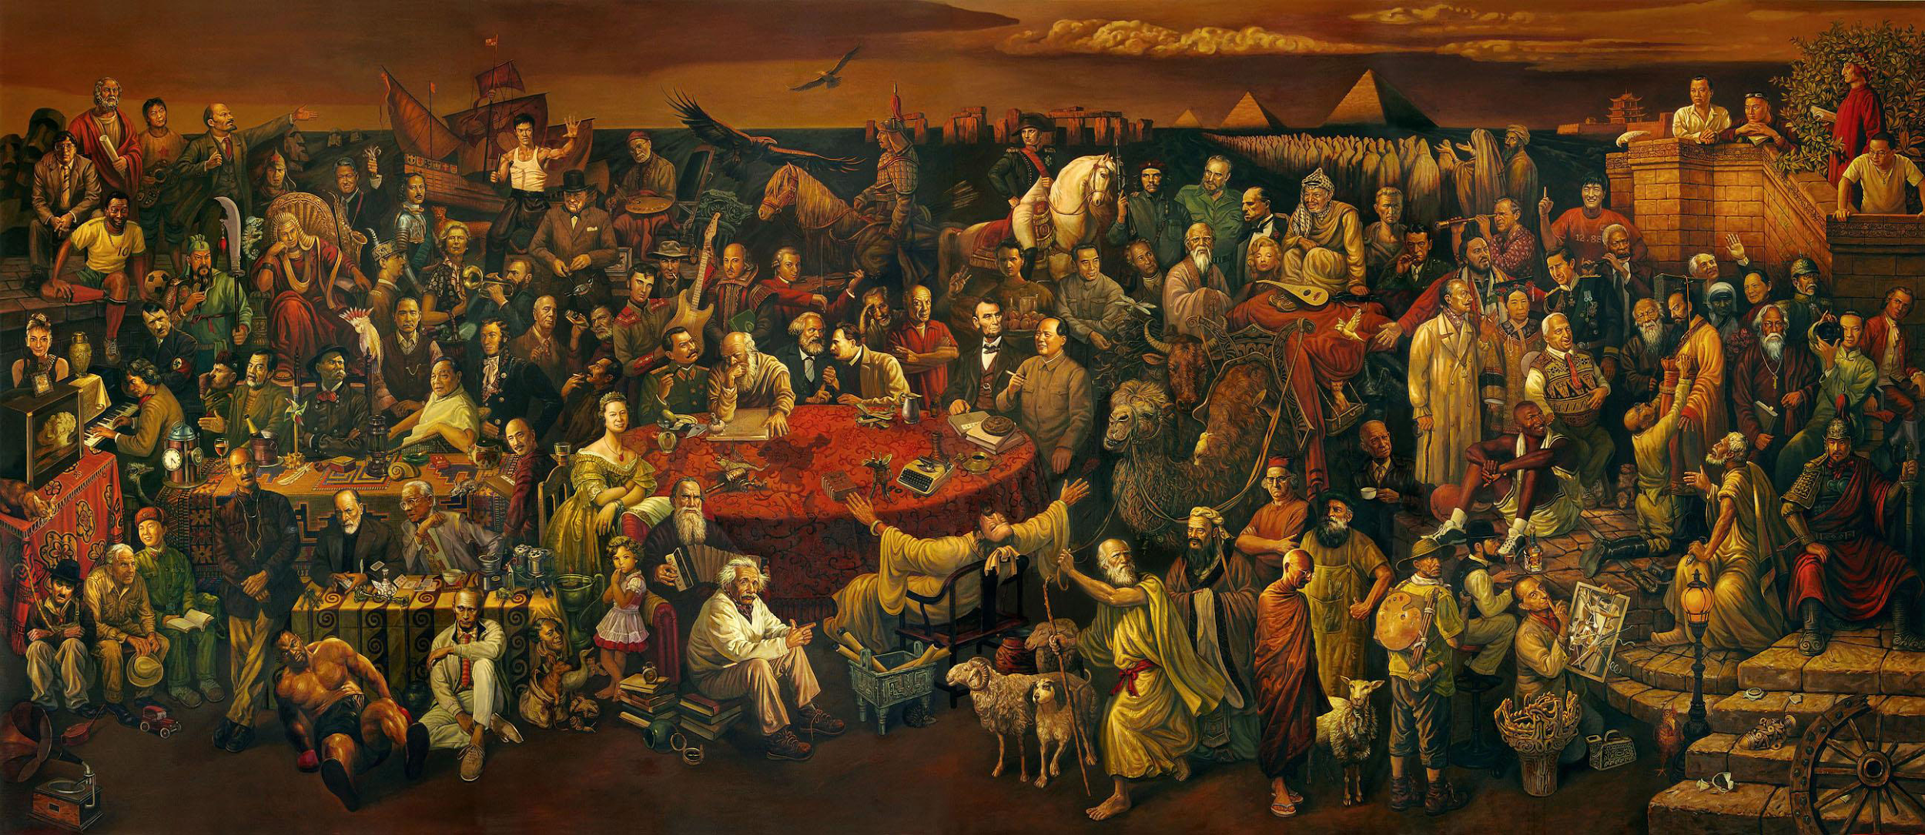
Questions?

